Slide 1
Lecture 04 Loop
Introduction to Repetition Structures
The while Loop: a Condition-Controlled Loop
The for Loop: a Count-Controlled Loop
Calculating a Running Total
Sentinels
Input Validation Loops
Nested Loops
Turtle Graphics: Using Loops to Draw Designs

Slide 2
Introduction to Repetition Structures
Repetition structure: makes computer repeat included code as necessary
  Includes condition-controlled loops and count-controlled loops

Slide 3
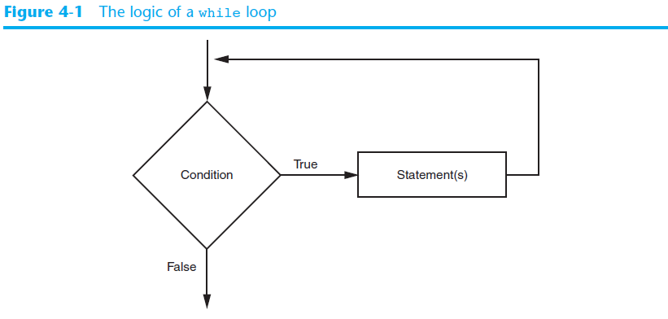
The while Loop

Slide 4
The while Loop
while loop: while condition is true, do something
  Two parts:
    Condition tested for true or false value
    Statements repeated as long as condition is true
  In flow chart, line goes back to previous part
  General format:
    while condition:
    statements

Slide 5

The for Loop
Count-Controlled loop: iterates a specific number of times
  Use a for statement to write count-controlled loop
    Designed to work with sequence of data items
      Iterates once for each item in the sequence
    General format:
    for variable in [val1, val2, etc]:
    statements

Slide 6
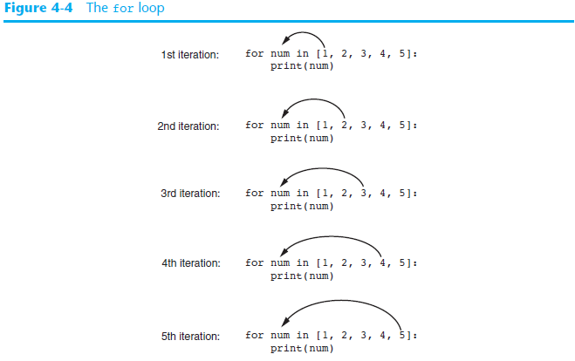

Slide 7
Using the range Function with the for Loop
The range function simplifies the process of writing a for loop
  range returns an iterable object
range characteristics:
  One argument: used as ending limit
  Two arguments: starting value and ending limit
  Three arguments: third argument is step value

Slide 8
Generating an Iterable Sequence that Ranges from Highest to Lowest
The range function can be used to generate a sequence with numbers in descending order
  Make sure starting number is larger than end limit, and step value is negative
  Example: range (10, 0, -1)

Slide 9
Calculating a Running Total
Programs often need to calculate a total of a series of numbers
  Typically include two elements:
    A loop that reads each number in series
    An accumulator variable
  Known as program that keeps a running total: accumulates total and reads in series
  At end of loop, accumulator will reference the total

Slide 10
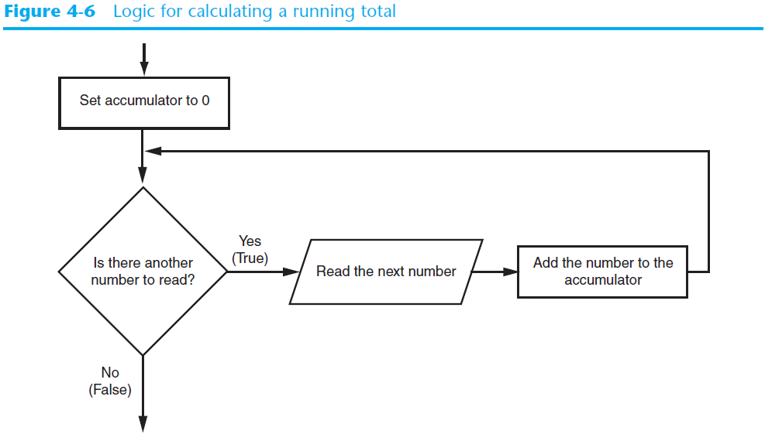
Calculating a Running Total (cont’d.)

Slide 11
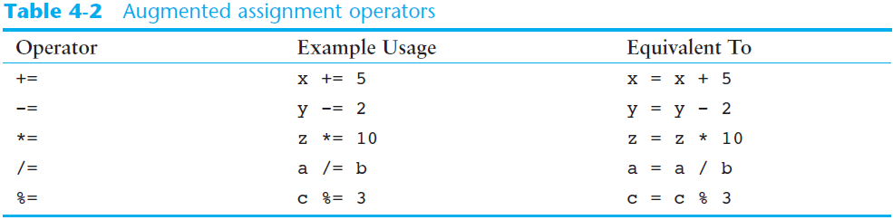
The Assignment Operators

Slide 12
Nested Loops
Nested loop: loop that is contained inside another loop
  Example: analog clock works like a nested loop
    Hours hand moves once for every twelve movements of the minutes hand: for each iteration of the “hours,” do twelve iterations of “minutes”
    Seconds hand moves 60 times for each movement of the minutes hand: for each iteration of “minutes,” do 60 iterations of “seconds”

Slide 13
Nested Loops (cont’d.)
Key points about nested loops:
  Inner loop goes through all of its iterations for each iteration of outer loop
  Inner loops complete their iterations faster than outer loops
  Total number of iterations in nested loop: number_iterations_inner x
  number_iterations_outer

Slide 14
Summary
This chapter covered:
  Repetition structures, including:
    Condition-controlled loops
    Count-controlled loops
    Nested loops
  Infinite loops and how they can be avoided
  range function as used in for loops
  Calculating a running total and augmented assignment operators
  Use of sentinels to terminate loops

